Slide 1
Effective Collation of Campus-Wide Learning Outcomes Using Google Documents
Laura Goadrich
Dean of Technology, Engineering and Mathematics
Bossier Parish Community College
Bossier City, Louisiana
Notes:
Log into docs.google.com
Open Learning Outcomes Spring 2011

Slide 2
Outline
Course Learning Outcomes
Program Learning Outcomes
Timeline
Google
Demo
Pros and Cons
Summary

Slide 3
Learning Outcomes
Course
Outcomes
Program
Outcomes
AAS Information Network Specialist
College Algebra
English
Network Essentials
...
Microsoft Window Server
Problem Solving and Programming Techniques
Psychology

Slide 4
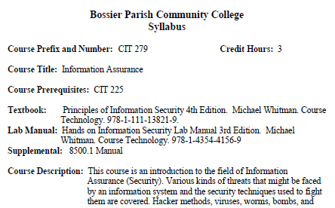
Learning Outcomes
Mapping Course Outcomes: http://bpcc.edu/academics/syllabi/

Slide 5
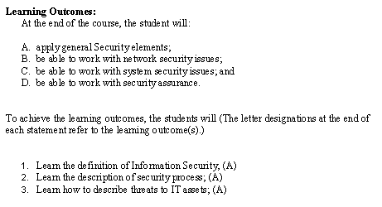
Learning Outcomes

Slide 6
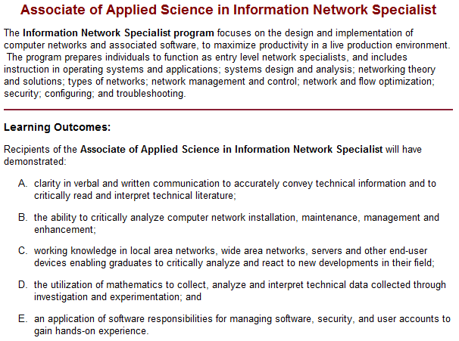
Learning Outcomes
Mapping to Program Outcomes
http://bpcc.edu/tem/

Slide 7
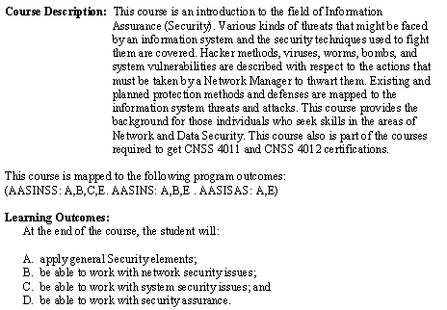
Learning Outcomes
Course Learning Outcome to Program Learning Outcome

Slide 8
Timeline
Define Outcomes
Evaluate Outcomes
Reflect on Results
Determine Methods for Improvement
Revise Outcomes

Slide 9
Timeline
Course Outcomes
Evaluated each semester
Faculty and program advisory board members
Define Outcomes- before semester classes begin
Evaluate Outcomes- last day of class in semester
Reflect on Results- within a week at the end of the course offering
Determine Methods for Improvement- within 3 weeks of the next semester
Revise Outcomes- by end of next semester
Faculty and program advisory board members
Faculty/adjuncts teaching courses
Faculty
Faculty
Notes:
The time frame that I am using is: - The first week of the semester, update the course Learning Outcomes sheets to include all courses. Learning Outcomes are released to all faculty/adjuncts to complete. - The first division meeting, have the faculty reflect on the prior semester courses and individual faculty comments for each course. The goal is to state if they are making the stated improvements in the courses and in the programs and if they have noticed any results. - Program directors (me this time) type up the course and program reflections from the faculty from the prior semester. - The advisory board meets to reflect on the course and program results.The feedback is updated on the same sheet. - The day that grades are due, learning outcomes are due. Course summaries are generated using the average of each course learning outcome. Program summaries are automatically generated.

Slide 10
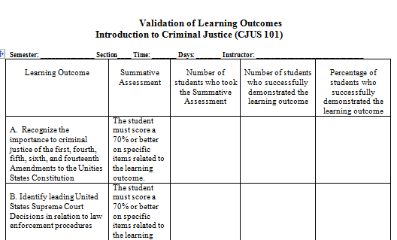
Timeline

Slide 11
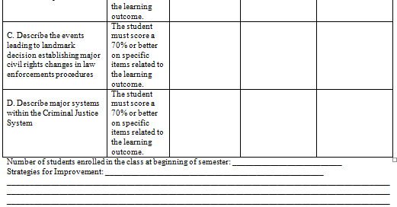
Timeline

Slide 12
Timeline
Program Outcomes
Evaluated each academic year
Faculty and program advisory board members
Define Outcomes- before fall semester
Evaluate Outcomes- last day of spring semester
Reflect on Results- first week of the next fall semester
Determine Methods for Improvement- by end of the next fall semester
Revise Outcomes- by end of the next spring semester
Faculty and program advisory board members
Faculty teaching courses
Program advisory board meets in spring semester as needed
Faculty and program advisory board members
Faculty and program advisory board members
Program advisory board meets in fall semester

Slide 13
Timeline
System/Procedure requirements
Flexible- data, analysis, text
Shared/Edited with multiple users
Used off and on campus
Secure
Simple
Easy to maintain
Minimum setup semester to semester
Printing format
Export abilities
Inexpensive

Slide 14
Google
Free!
Integrated system (documents, gmail, calendar, picasa, maps, voice)
Initially given 8 Gigs
Automatic saving
99.9% cloud uptime
Requirements for users: email address
Up to 50 simultaneous editors allowed at the same time, 200 viewers
Private, shared or public file storage
Constantly updated
Recovery system- view the history of the document
Documents similar to Word, Excel, PowerPoint

Slide 15
Google
http://www.youtube.com/watch?v=J-3s574poHY&feature=related
Notes:
Google Docs in Plain English
Why are learning outcomes moving to Google Docs?
Logging into Google Docs
Go to http://docs.google.com
Click on “Create an account now”
Complete all steps and click “I accept. Create my account.”
Log into Google Docs using your new account.
Accept the Google Docs that I have already invited you to by logging into your campus email.
Go to http://www.bpcc.edu
Click on Faculty and Staff tab.
Click on Campus mail.
Log into the WebMail (just like you would log into your BPCC computer).
Find the email I sent you earlier for your Google Docs.
Click on “Accept” in the email to view the Google Docs.
After a moment, your “accepted” Google Doc should appear in the table of contents.
Instructions for entering your Learning Outcomes into Google Docs (handout).
Your Learning Outcomes are due by the deadline set by Peggy Fuller via the online Google Documents. Please contact Lisa Fincher if you have any questions after this training session about entering your information in the Division’s online Learning Outcomes.

Slide 16
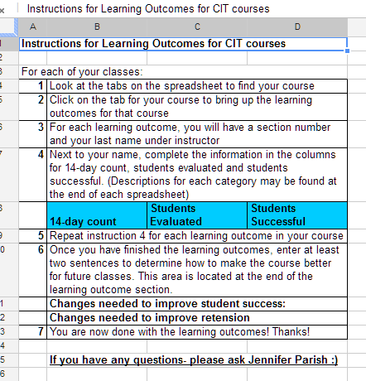
Google
Google Docs Learning Outcomes instructions

Slide 17
Google
Training
Small groups (5-10)
Train
Administration
Staff
Faculty (those comfortable with the computer first)
Adjuncts
30 minutes to 1 hour
Handouts for all instructions
Snacks

Slide 18
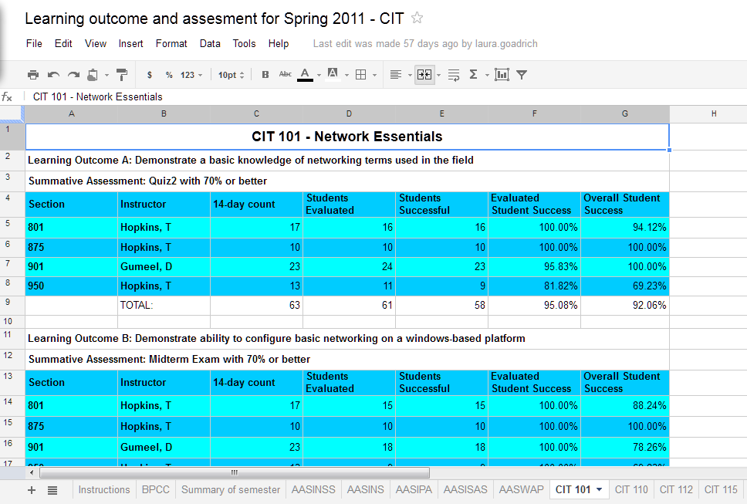
Google
http://docs.google.com/

Slide 19
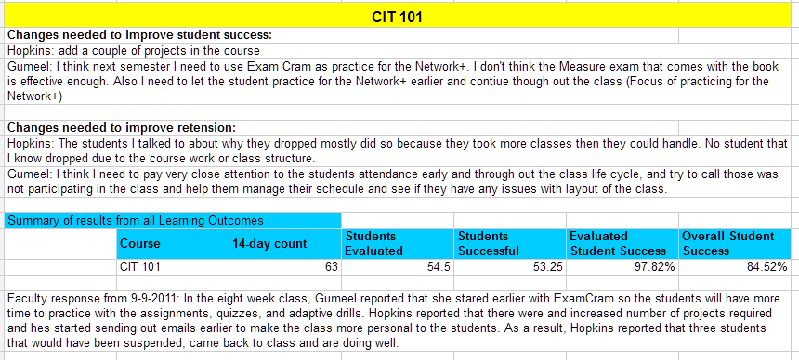
Google
Course outcome reflection and review

Slide 20
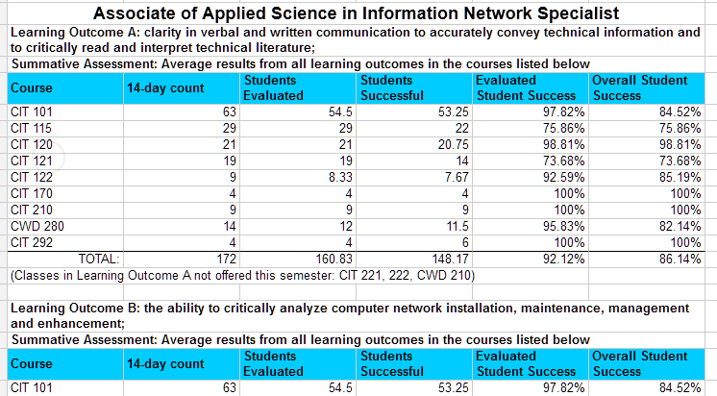
Google
Course outcomes to program outcomes

Slide 21
Summary
Start of the semester
First semester spreadsheet creation- 2-3 days
Copy and paste learning outcomes from posted master syllabi
Enter the section and faculty for each course in the semester
Faculty will need to complete the summative assessments along with the
Link courses with program outcomes
Future semester spreadsheet- 3-4 hours
Confirm learning outcomes and links are updated as needed
Enter the section and faculty for each course in the semester
End of the semester- 2-3 hours
Review the links/sums are correct for course and program learning outcomes
Copy and paste the course learning outcome comments into a summary page
Format data to print to PDF and share
Reflection updates to the program/course
Faculty reflection on each course/program- 1 hour each
Creation of summary page with all summary comments- 3-4 hours

Slide 22
Summary
Benefits
Faculty can enter data any time/ any where there is any Internet connection
Once the information is entered and linked, just copy for the next course/program offering
Faculty can see how all course sections are performing; encourages collaboration
Disadvantages
Not a database
Links/sums can be changed accidentally and need to be reviewed after faculty input their data
Still requires a review by all entities

Slide 23
Thanks! Questions?
LGOADRICH@BPCC.EDU
http://LAURA.GOADRICH.COM/sacs

